Slide 1
Intro to SQL +sqlite3
Brendan Smyers

Slide 2

What is SQL
SQL (Structured Query Language) is a standardized programming language that is used to manage, query, and manipulate relational databases.
Notes:
SQL forms the backbone of over 100,000+ companies small and large.

Slide 3
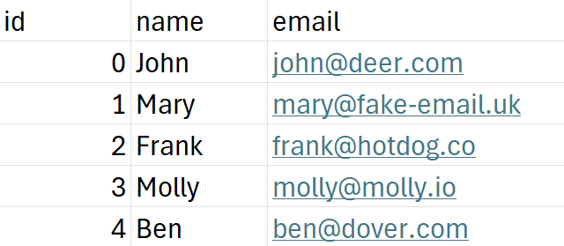
SQL Basics
SQL stores data in Tables
users table
Tables have Columns
id, name, email
Tables also have Rows
0, John, john@deer.com
Rows can have Primary Keys
id is the primary key column
‘users’ table

Slide 4
SQL Basics
Data
Definition
CREATE
ALTER
DROP
TRUNCATE
Data
Manipulation
INSERT
DELETE
UPDATE
Data
Query
SELECT
Data
Filters
WHERE
AND
OR
IN
…
Aggregate
Functions
COUNT
SUM
AVG
MAX
…
Notes:
There are a lot of SQL keywords.
There are keywords to manage Tables, Rows and filter Columns.
This doesn’t even cover half of them.

Slide 5
SQL Basics
Data
Definition
CREATE
ALTER
DROP
TRUNCATE
Data
Manipulation
INSERT
DELETE
UPDATE
Data
Query
SELECT
Data
Filters
WHERE
AND
OR
IN
…
Aggregate
Functions
COUNT
SUM
AVG
MAX
…
Notes:
Fortunately for us we won’t be need all of them.
For our purpose we will be using these keywords along with a couple others not listed.

Slide 6
SQL Basics – Make some Queries!
Try these example queries:
SELECT first_name, last_name FROM Customers;
UPDATE Customers SET first_name = "Mary" WHERE customer_id = 1;
SELECT age FROM Customers WHERE country = “USA”;
DELETE FROM Shippings WHERE status = "Delivered";
Notes:
Before we get into the hands-on portion, let’s make some queries to an example database.
Hopefully this will help you get a better understanding of the language.
https://www.programiz.com/sql/online-compiler/

Slide 7

SQLite Example – API Backend
Implement basic CRUD functionality
Write SQL queries for each operation
Learn how to use JS + SQLite3 to store data

Slide 8

Sqlite3 Example - SETUP
Clone the sample project
Install dependencies
npm i -g pnpm
pnpm install
Start the frontend + backend
pnpm dev
4. Visit http://localhost:3000
Notes:
https://github.com/ohio-software-development/sqlite3-example/tree/main
npm I –g pnpm
pnpm install
pnpm dev
http://localhost:3000

Slide 9
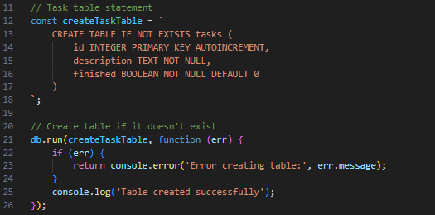
SQLite Example – Tasks Table
Create a tasks table in the database if it does not exist
“IF NOT EXISTS” will prevent sqlite3 from creating duplicate tables
Notes:
Link to source code commit:
https://github.com/ohio-software-development/sqlite3-example/commit/c82d3d59f37da1cab5a537e012090045255fb9c5
Explain query.

Slide 10
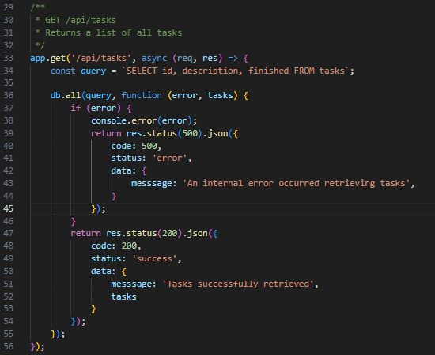
SQLite Example – READ
Return list of tasks with their ids and descriptions
If an error occurs, send an error instead
Notes:
Link to source code commit:
https://github.com/ohio-software-development/sqlite3-example/commit/c82d3d59f37da1cab5a537e012090045255fb9c5
Explain query.
Explain how code works/what its doing.
Much of the remaining code looks the same. Just changes to the query

Slide 11
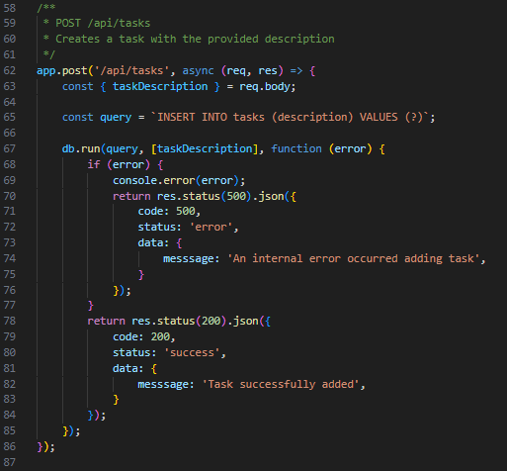
SQLite Example – Create
Insert task into ‘tasks’ table
No need to specify ‘id’ or ‘finished’ because they have default values
If an error occurs, send an error instead
Notes:
Link to source code commit:
https://github.com/ohio-software-development/sqlite3-example/commit/c82d3d59f37da1cab5a537e012090045255fb9c5
Explain query.

Slide 12
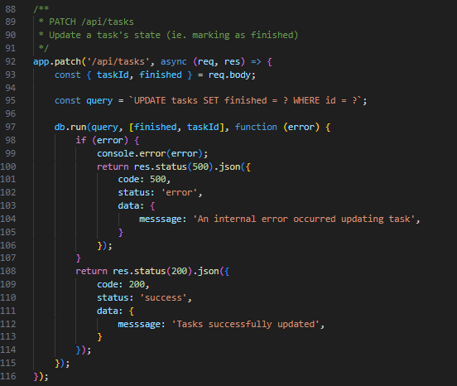
SQLite Example – UPDATE
Change task completion status
If an error occurs, send an error instead
Notes:
Link to source code commit:
https://github.com/ohio-software-development/sqlite3-example/commit/c82d3d59f37da1cab5a537e012090045255fb9c5
Explain query.

Slide 13
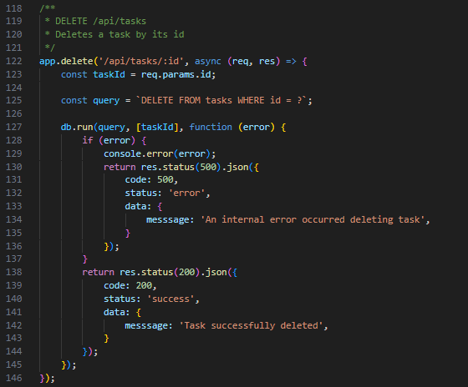
SQLite Example – DELETE
Delete a task by id
If an error occurs, send an error instead
Notes:
Link to source code commit:
https://github.com/ohio-software-development/sqlite3-example/commit/c82d3d59f37da1cab5a537e012090045255fb9c5

Slide 14
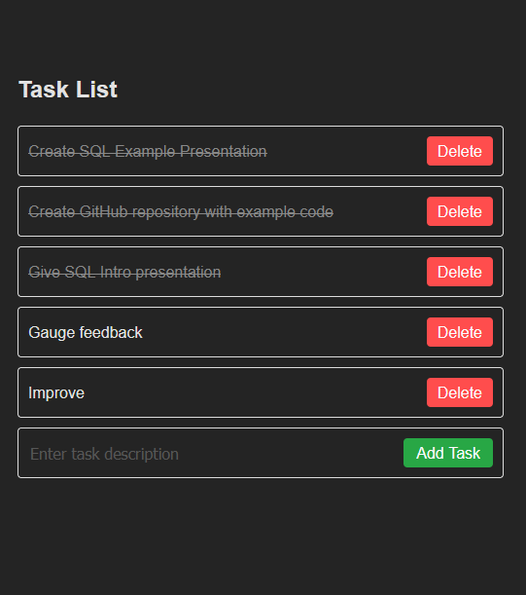
THANK YOU

